Slide 1


ANALYSIS of Social Buzz
Presented by: Ahmad Tawsif

Slide 2


Today's agenda
Project recap
Problem
The Analytics team
Process
Insights
Summary

Slide 3

Social Buzz - Social Media and Content Creation (2008)
Over 500 million active users
250 employee, 200 tech employee
They require external expertise for 3 reasons: - Looking to go on IPO - Small company - Learn data practises from large company
3 months initial trial with Accenture
Project Recap

Slide 4


Unstructured Data Not Much Clean Data
Large Data Set Higher Number of Variables for Analyzing Result
Problem

Slide 5
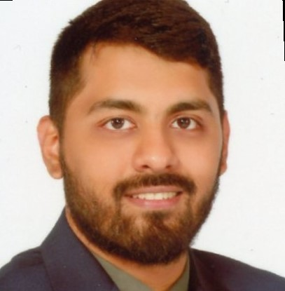


Ahmad Tawsif Data Analyst Intern
The Analytics team
Marcus Rompton Senior Principle
Andrew Fleming Chief Technical Architect

Slide 6
Process
1
Data Cleaning
2
Data Gathering
3
Identifying Performance Indicators
4
Data Analysis
5
Unfolding Data Insights

Slide 7

Insights

Slide 8
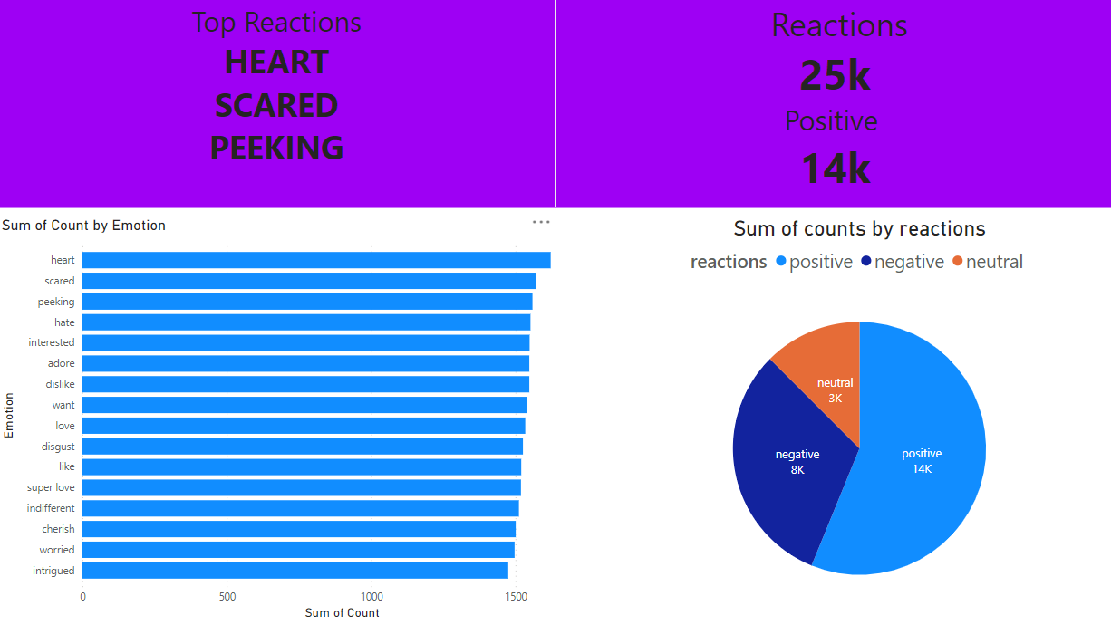

Slide 9
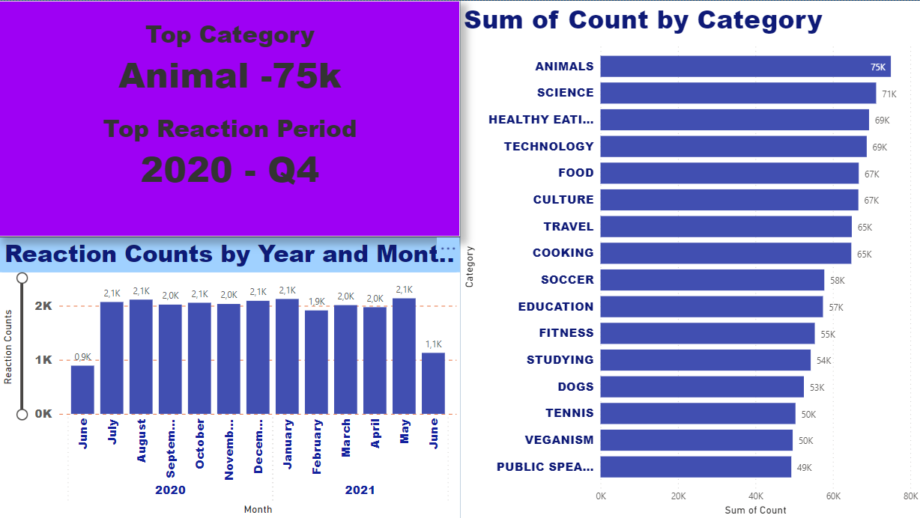

Slide 10
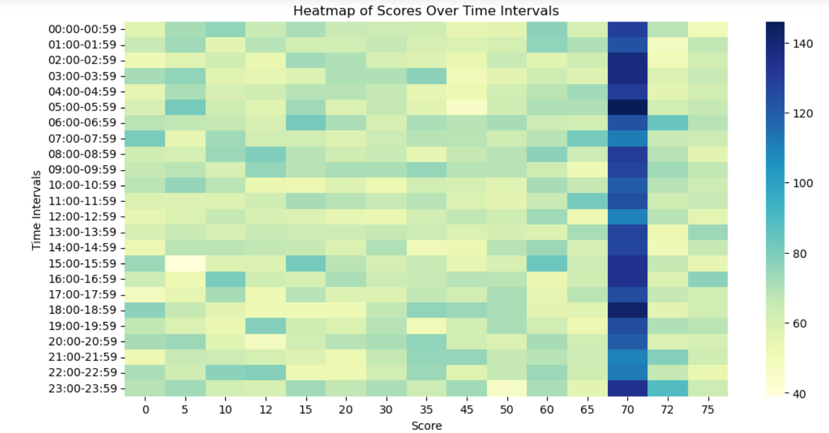
Heat map of scores

Slide 11

Positive feedbacks are on top
Heart reactions heading first
Score 70 gets more hits
December, January are top months
Need different stategies for June
Less feedback between 11:00-15:00
Summary

Slide 12

Thank you!
ANY QUESTIONS?

